Slide 1

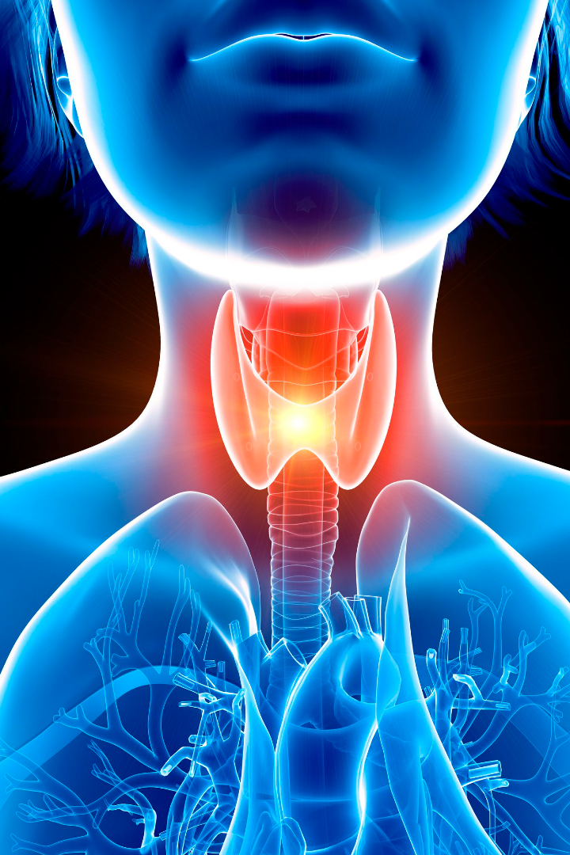
PRASAD V POTLURI SIDDHARTHA INSTITUTE OF TECHNOLOGY
Thyroid Detection
The thyroid gland plays a crucial role in regulating metabolism, growth, and development.
Presented by:
G.HARSHINI (22501A0556)
E.HARI KRISHNA (22501A0545)
G.LAKSHMI PRIYANKA (22501A0546)
Ch. SAI DHEERAJ (22501A0532)

Slide 2
Table of Contents
INTRODUCTION
PROBLEM STATEMENT
PROCESS TO DO IN PROJECT USING ML
FLOWCHART
CODE EXPLANATION
RESULT OF THE CODE
CONCLUSION

Slide 3
Problem Statement
Machine learning models offer the capability to analyze extensive healthcare datasets, uncover exclusive patterns, and detect challenging-to-discern risk factors that conventional methods might miss. These algorithms can predict an individual's Thyroid by examining their health records and lifestyle factors.
Clinical evaluation includes a detailed medical history and physical examination. Blood tests measure thyroid hormone levels (TSH, Free T4, Free T3).

Slide 4
Process Required to Do in Project using Machine Learning
Data Collection
Data Pre-Processing
Gather a comprehensive dataset of thyroid-related data for training the machine learning model
It involves cleaning and transforming raw data into a format that is suitable for analysis or training machine learning models.
Data Visualization
Train and Test Split
Data visualization is the graphical representation of data to communicate information, patterns, and insights effectively.
one for training the model and another for testing or evaluating the model's performance.

Slide 5
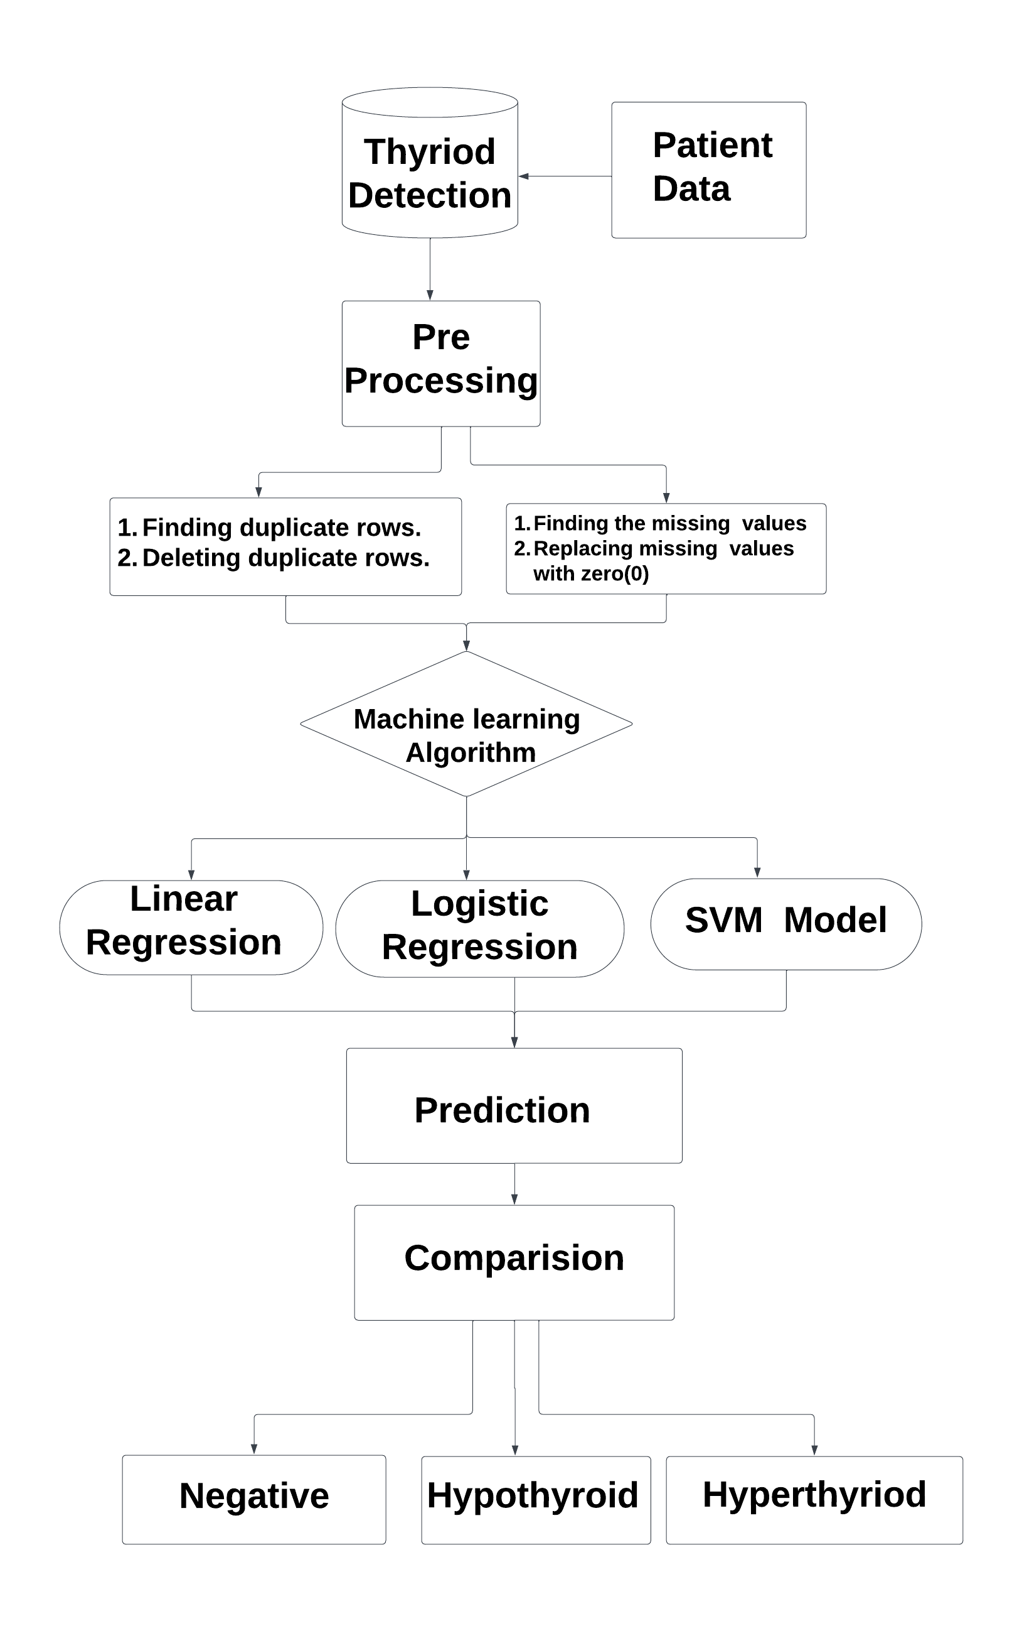
Project FLOWCHART

Slide 6
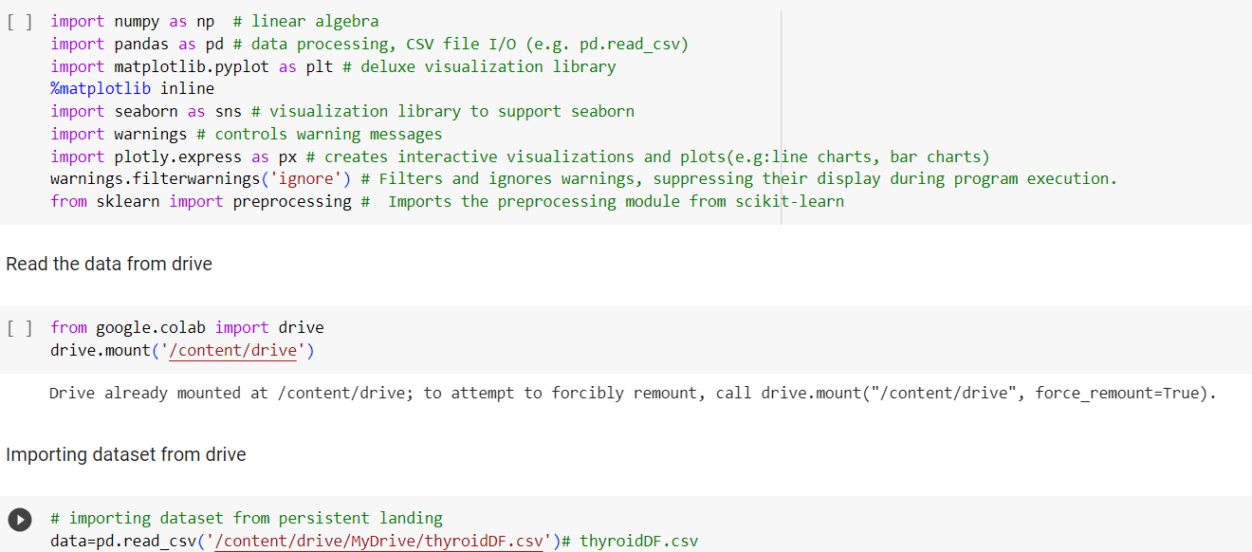
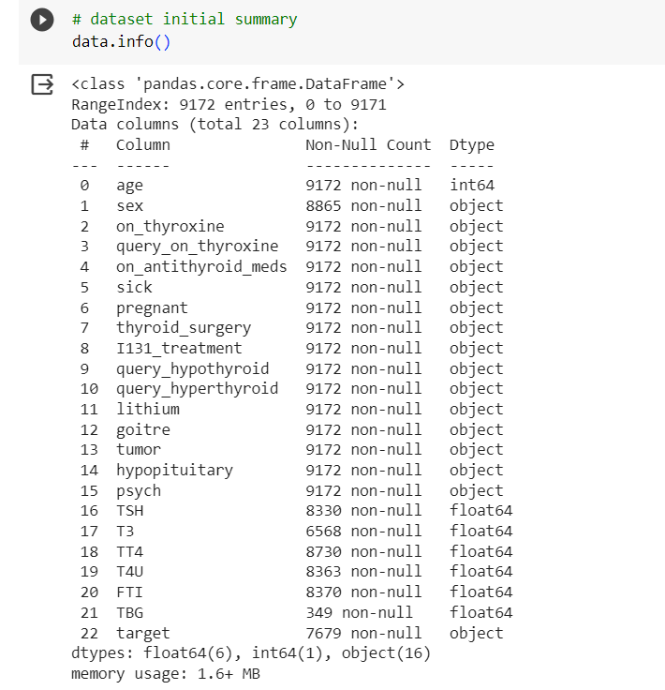
DATA COLLECTION
Data collection is the process of gathering raw information and observations to build a dataset for analysis, research, or other purposes.
First import important library functions which are useful to do project.
The data is collected from Kaggle app and data is uploaded into the drive and path of the Dataset is copied into the Google Collab.

Slide 7
Data Pre Processing
The primary goals of data preprocessing are to address issues such as missing values, outliers, and inconsistencies, and to prepare the data in a way that enhances the performance and interpretability of machine learning models.
CHECKING FOR DUPLICATE DATA
REMOVING DUPLICATE DATA
CHECKING FOR NULL VALUES
FILLING MISSING DATA
DATA VISUALIZATION

Slide 8
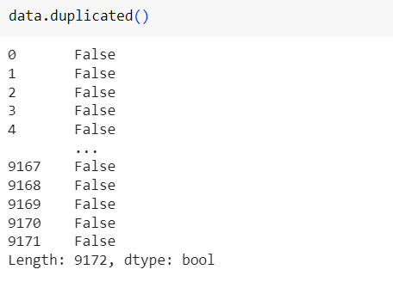
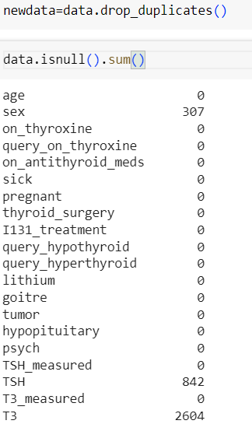
CHECK FOR DUPLICATE DATA
Finding and handling duplicate values in Python is most important for several reasons like data quality, accuracy etc.
For removing duplicates we use the code data.duplicated() and it displays duplicated values.
Duplicate values can introduce inaccuracies and noise into the dataset. Eliminating duplicates helps maintain a higher level of data quality, ensuring that your analyses and models are based on reliable information.

Slide 9
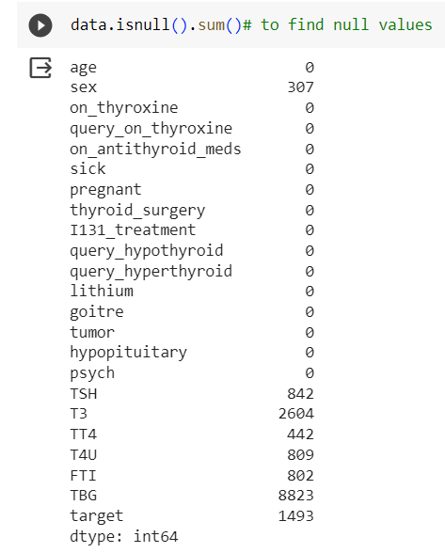
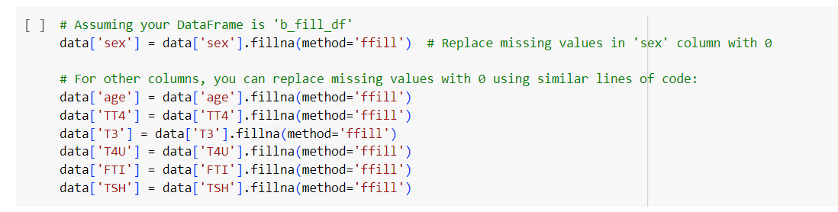
CHECK FOR NULL VALUES
We are Checking for the NaN /Null Values in the Dataset.
If the Data Contains the Null Values it is not possible to visualize data.
So we need to fill the Data with ‘0’,’ ffill’, ’bfill’.
This would also increase the accuracy.

Slide 10
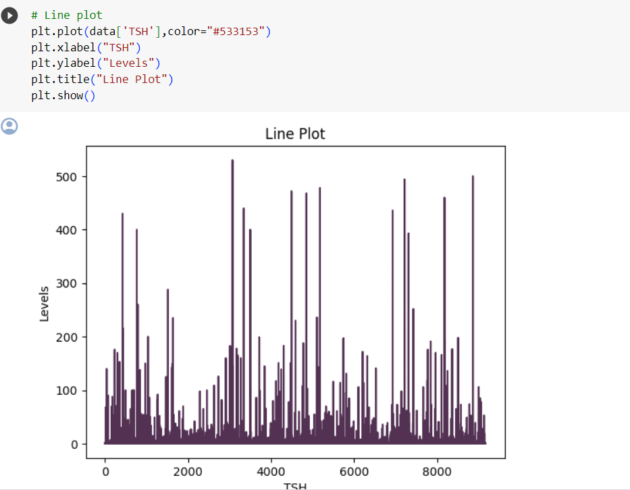
Data visualization
1.Data visualization in Python is crucial for several reasons, especially when working with large and complex datasets.
2.Visualization provides an intuitive way to explore and understand complex datasets. It allows you to identify patterns, trends, and relationships in the data that may not be immediately apparent in raw numbers.
3. Data visualization is the graphical representation of data to communicate information, patterns, and insights effectively.

Slide 11
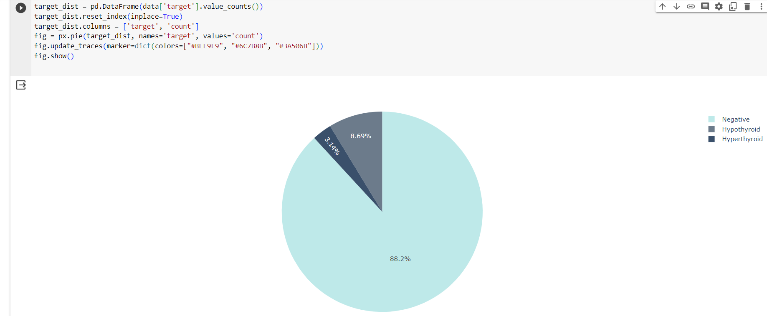
Representing the target in pie chart

Slide 12
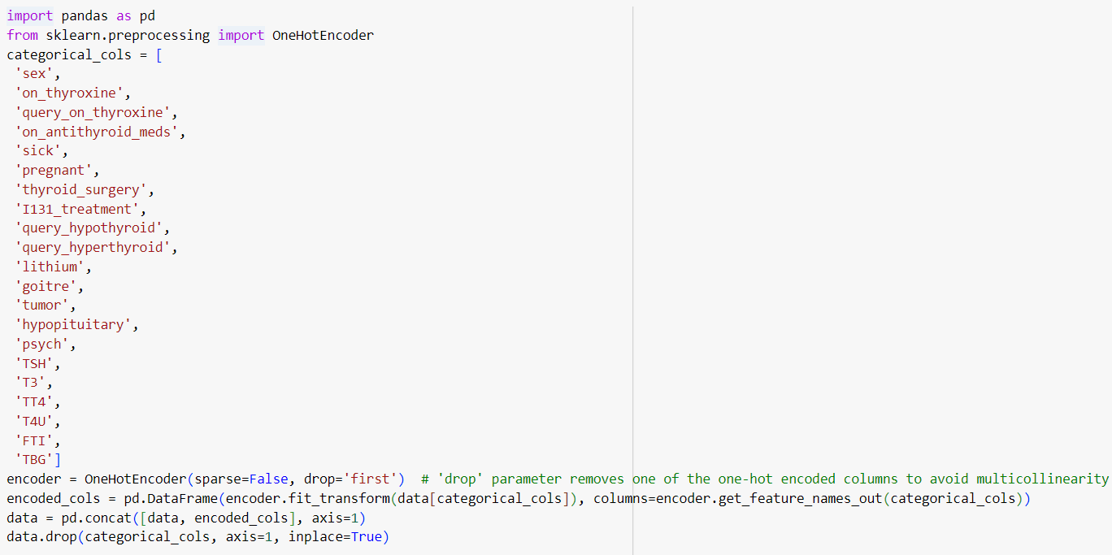
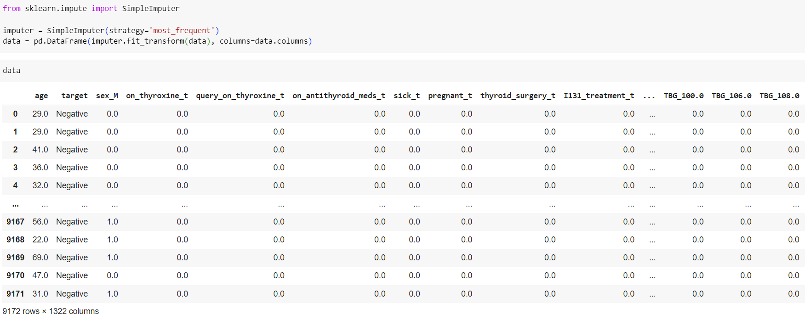
DATA NORMALIZATION
ONE HOT ENCODING :
One-hot encoding is a technique used in machine learning and data preprocessing to represent categorical variables as binary vectors. It is particularly useful when dealing with categorical data.
One-hot encoding is used for ‘input’ variables in the Dataset.

Slide 13
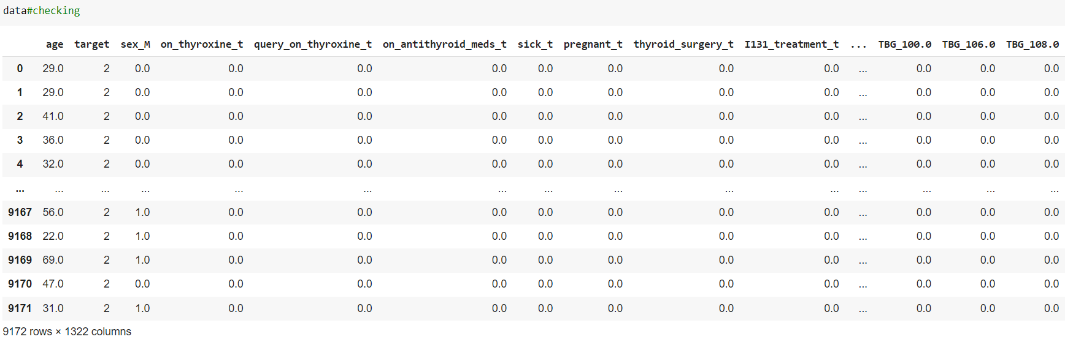
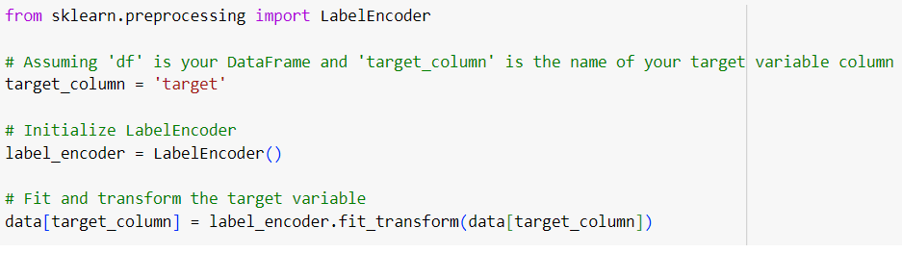
LABEL ENCODER:
1. The Label Encoder is a preprocessing tool used in machine learning to convert categorical labels into numerical representations. It is particularly useful when working with algorithms that require numerical input for target variables.
2. Label Encoder is used for ‘output’ variables like “target” int the Dataset.

Slide 14
Train Model
We use a dataset to train the model using various machine learning algorithms. Training a model is important so that it can understand the various patterns, rules, and features.
ML Algorithms:
1.Logistic Regression:
It is like making a smart guess when you have to choose between just two options, like 'yes' or 'no.' It helps you figure out the chances of something happening or not happening.
2.Linear Regression:
Linear regression is a bit like drawing a straight line through points on a graph. Imagine you have some dots on paper, and you want to connect them with a line. Linear regression helps you find the best line that fits those dots.
3.SVM Model:
SVM is a versatile supervised learning algorithm used for both classification and regression tasks. The choice of the kernel function in SVM allows it to capture complex relationships in the data, making it effective in various scenarios.

Slide 15
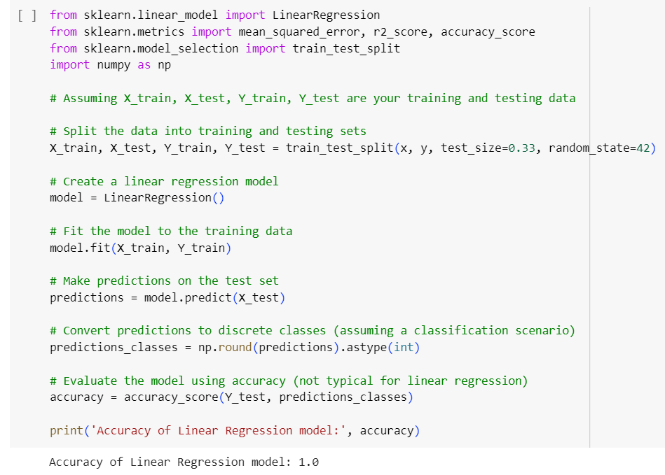
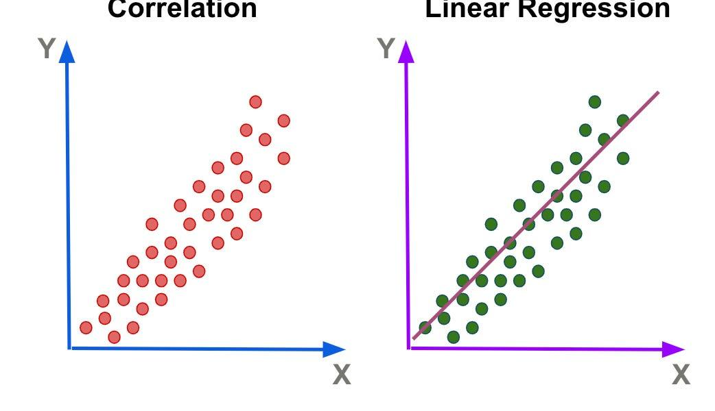
LINEAR regression
Linear regression is a bit like drawing a straight line through points on a graph.
A Regression analysis is a method for modeling relationships between variables.

Slide 16
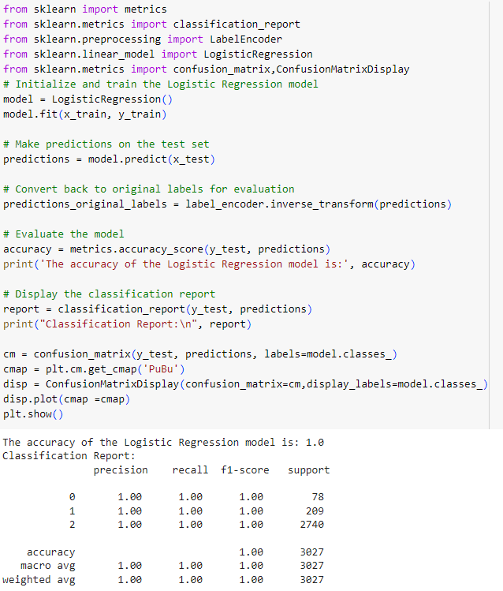
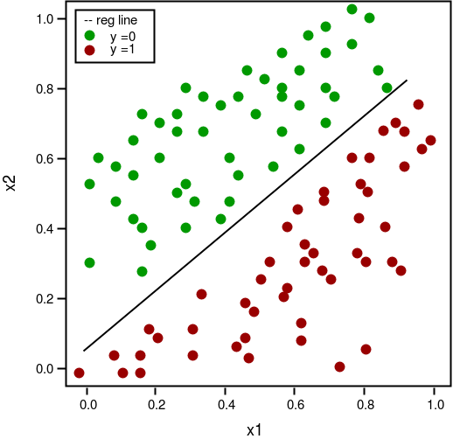
Logistic regression
Logistic regression is a statistical method used for binary classification problems, where the dependent variable is categorical and represents two classes (usually 0 and 1). Despite its name, logistic regression is used for classification rather than regression.

Slide 17
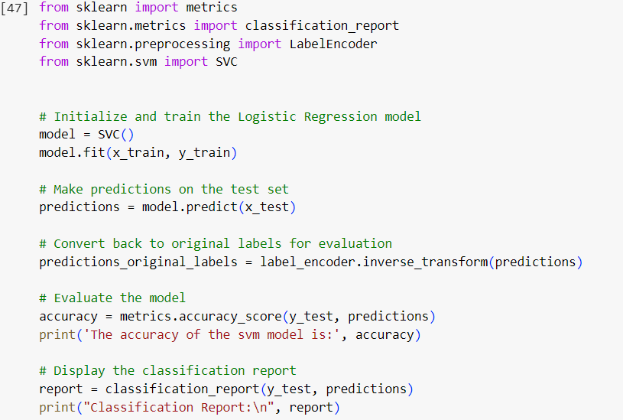
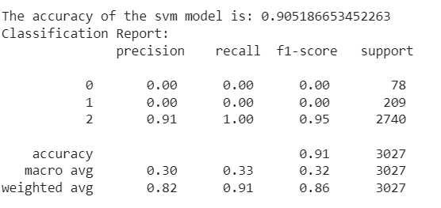
SVM MODEL
SVM is used in thyroid detection project alongside linear and logistic regression can enhance the model's ability to handle non-linear relationships, high-dimensional data, and outliers. It provides a overall performance, especially in scenarios where a more complex decision boundary is required.

Slide 18
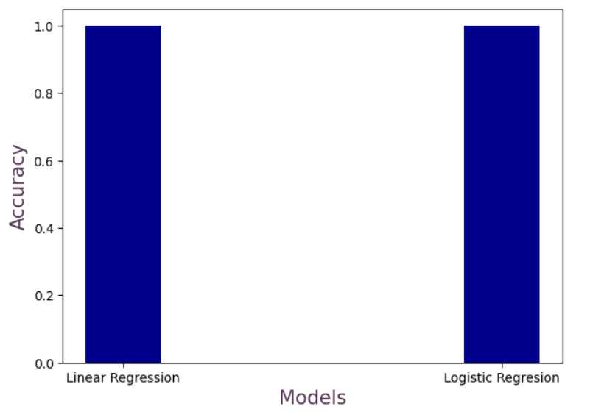
Comparison between Linear and Logistic Regression
The following plot is a comparison between accuracies of Linear and Logistic Regression.

Slide 19
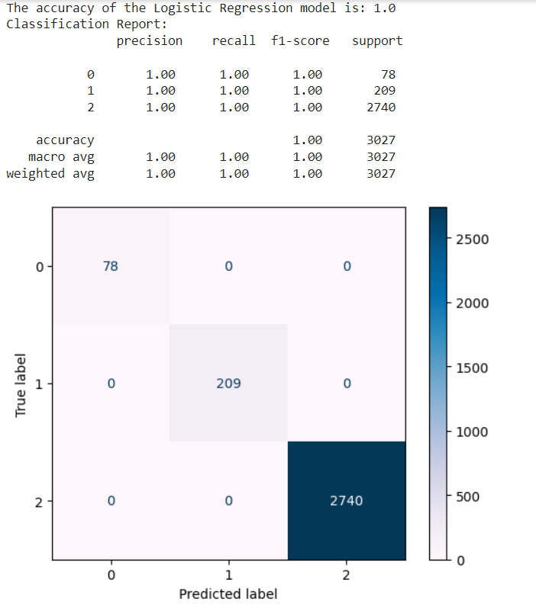
Result
ACCURACY FOR LOGISTIC REGRESSION:
ACCURACY FOR LINEAR REGRESSION:
ACCURACY FOR SVM MODEL:

Slide 20
CONCLUSION
The thyroid detection project aimed to develop a predictive model to determine whether an individual has thyroid-related conditions based on a given dataset.
In conclusion, the thyroid detection project demonstrated the potential of machine learning techniques in predicting thyroid conditions based on patient data. The project's success relied on a holistic approach that integrated domain knowledge, data preprocessing, model development, and careful evaluation.

Slide 21
THANK YOU

